Slide 1
WindowDash
Brendan and Lucas

Slide 2
Team
Brendan Taylor
Lucas McColgan

Slide 3
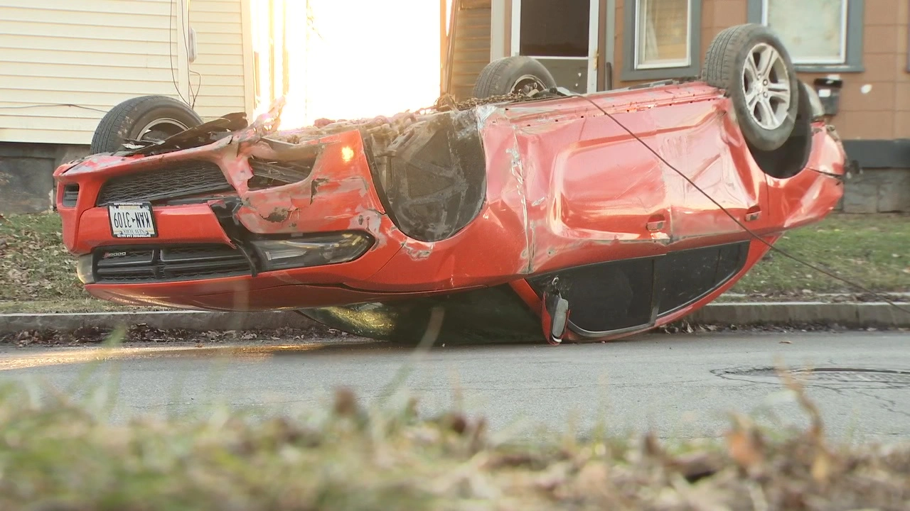
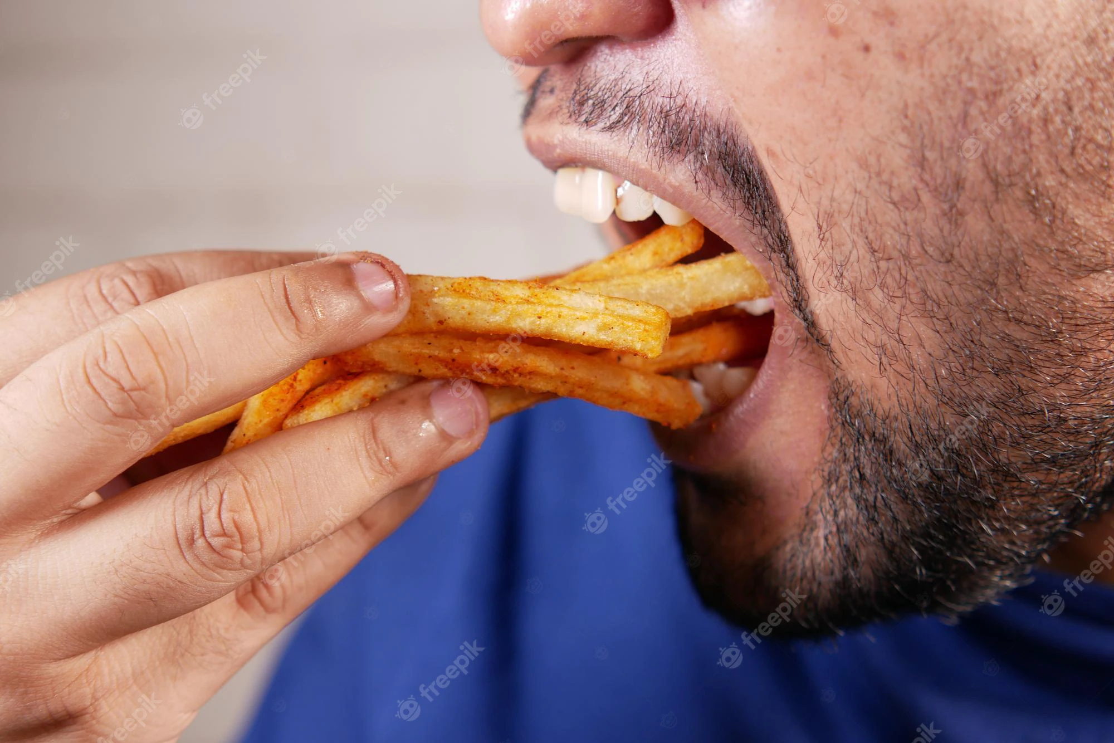
Problem
Doordash involves the usage of a driver, these drivers may not always be available, and are rather expensive as a car isn’t the most gas efficient vehicle to transfer packages. They may also not properly complete the delivery.

Slide 4
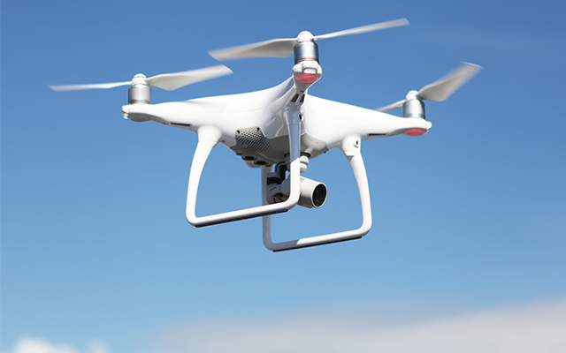
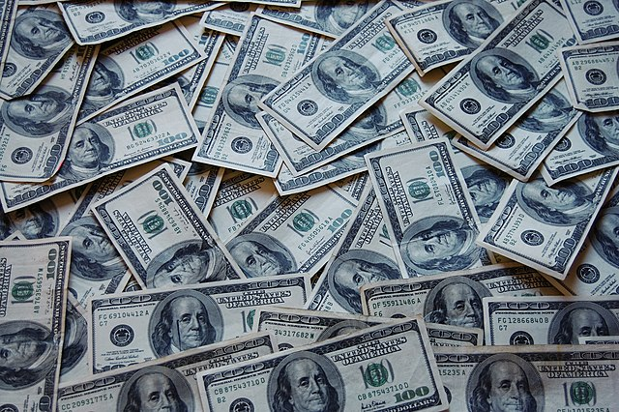
Solution
In our solution, we decided that replacing the driver and cars with automated drones would solve all of these issues. Drones are always available to be ordered from, are cheaper to operate for the customer, and don’t need to take the roads.

Slide 5
Demo

Slide 6
Lessons Learned
We learned that making a “website” map is a good idea for layout planning.
Assign a scope to the project to make sure it doesn't go outside of that scope (ie too many webpages).
Cookies have hard syntax.
Apparently linking EC2 servers and Databases are hard

Slide 7
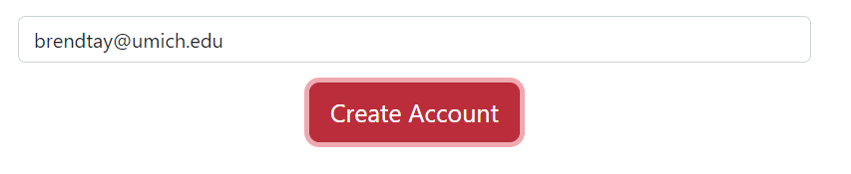
Issues/Bugs Known
If the user enters a name already in the database, the button turns red and won’t change back.
When the server restarts, it forgets user id’s and sets them all to 0’s.
The system will let the user continue if they press the button twice.

Slide 8
Future Versions
Multiple Deliveries at a time
An algorithm that determines price by distance
Suggestions based per user
A ordering system that is based per user
Make it more visually appealing

Slide 9
Thank you!
Any questions?

